Slide 1

Provider Web Portal (PWP)
Training

Slide 2
PWP Features
Provider Manual/
Benefit Grid
Eligibility
Claims
Entity
Management
Authorizations
Remittance Advice
Patient Management

Slide 3
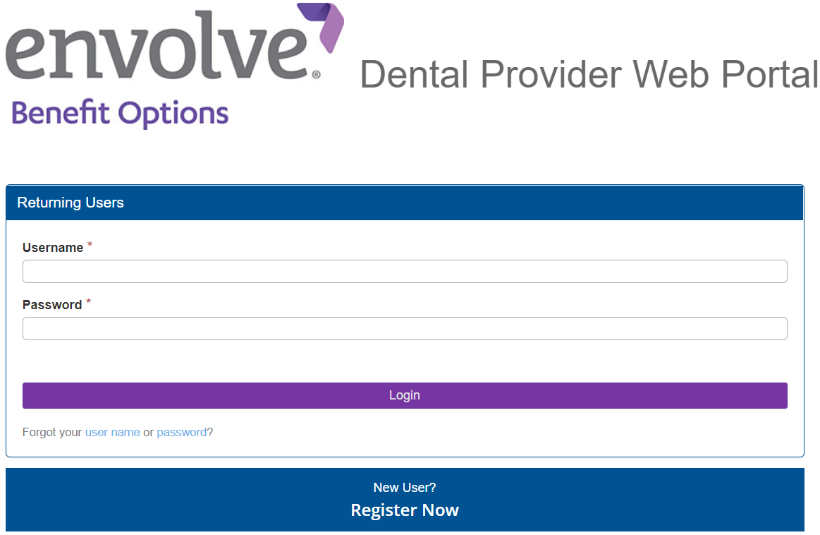
Website and Log In
Navigate to https://pwp.EnvolveDental.com on your web browser
Sign in using your username and password

Slide 4
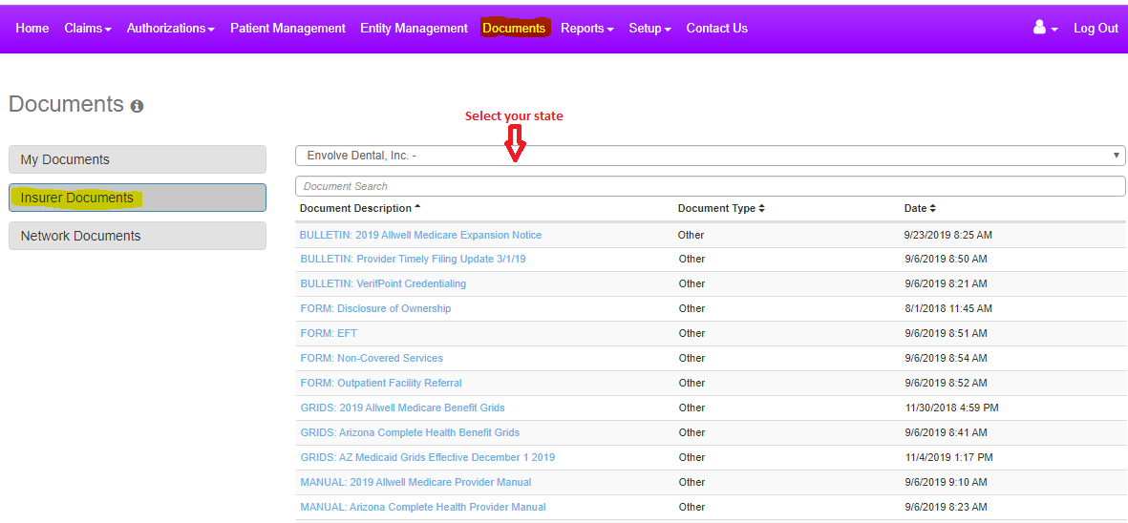
Provider Manual/Benefit Grid
Find the provider manual and benefit grid using the purple bar at the top of the page. Navigate to:
  Documents > Insurer Documents > Select your state

Slide 5
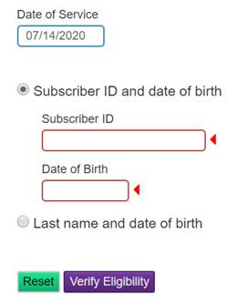
Eligibility
On the landing page is our member Eligibility feature to check active enrollment
Select the Location and Provider
Enter a Date of Service (it will only let you go back 30 days)
Enter the Subscriber ID/DOB and click “Verify Eligibility”
Users can also start a claim after checking eligibility
If you have additional questions regarding eligibility, please contact Customer Service at the phone number listed in your provider manual

Slide 6



Claims
Claims feature includes:
Claim Submission
Claim Dashboard
Claim Search/Status
This section will cover the features above and these:
Corrected Claims
Claim Appeals
Timely Filling Deadlines

Slide 7
Claim Submission
Three ways to submit claims:
1
  Provider Web Portal
2
  Electronic Clearing House (Payer ID: 46278)
3
  Mail (For address, check your provider manual/Contact Customer Service)

Slide 8
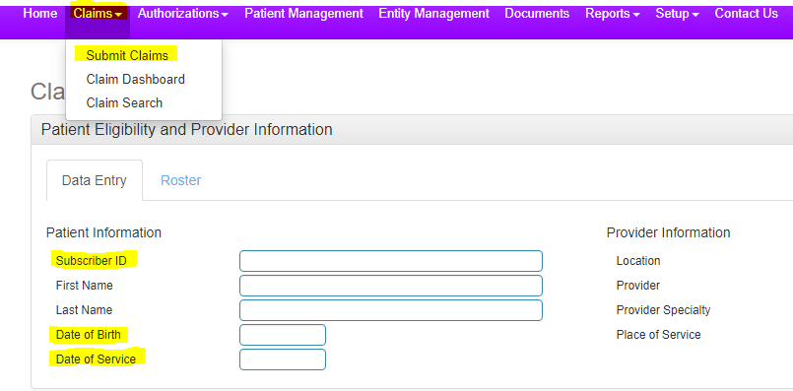
Claim Submission in Provider Web Portal
Using the purple bar at the top, navigate to:
  Claims > Submit Claims
Online claim form is similar to paper ADA form
Fill out necessary information corresponding to the date of service

Slide 9
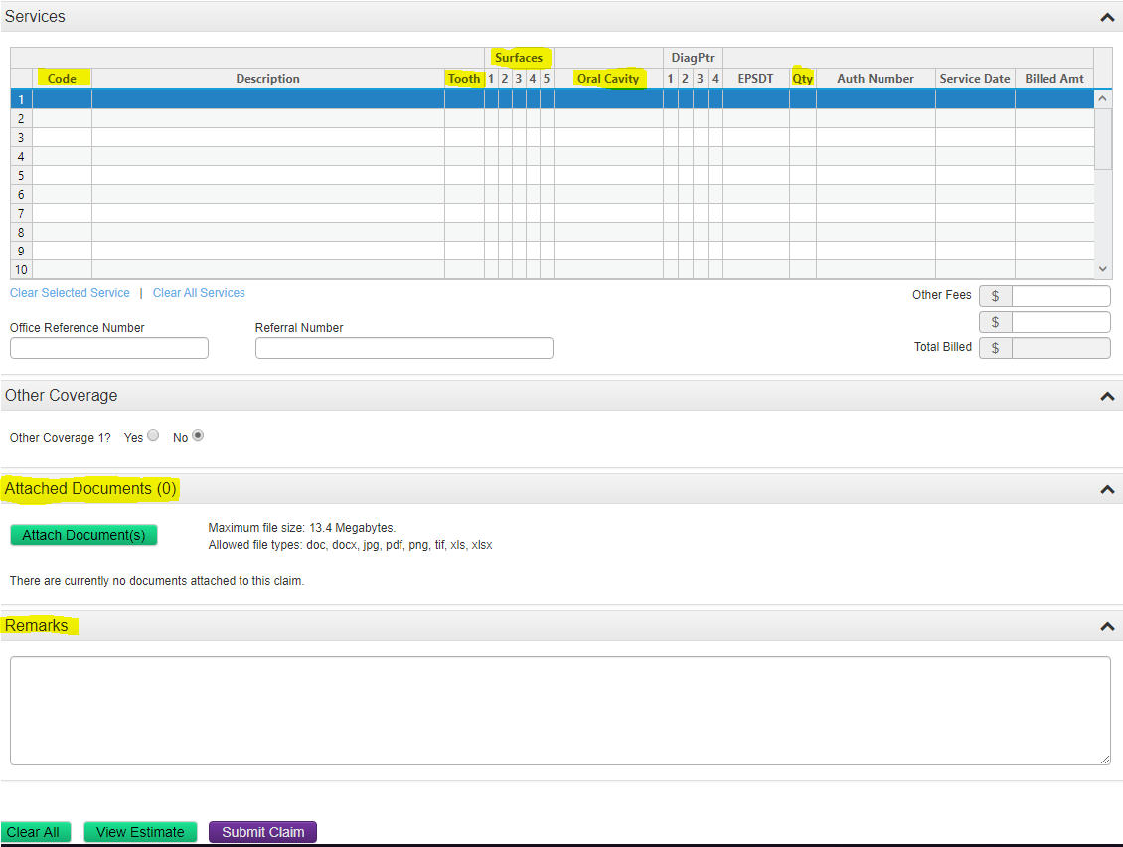
Claim Submission in Provider Web Portal
Continue to fill claim submission form online
  Fill Service code(s)
  Attach documentation
  Enter remarks

Slide 10
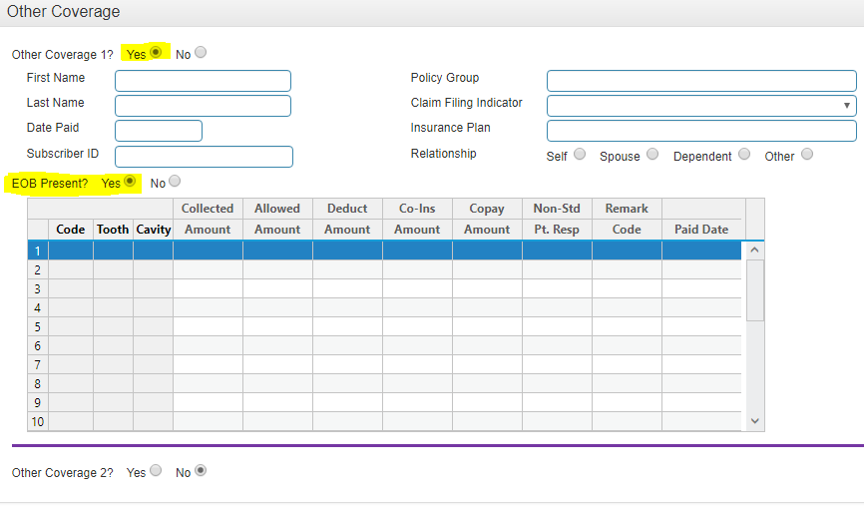
Claim Submission in Provider Web Portal
When “Other Coverage” is selected, it will open a filed to enter more information
  It will also ask if the Explanation of Benefits is included
  If yes, it will as to enter the code(s) and rates

Slide 11
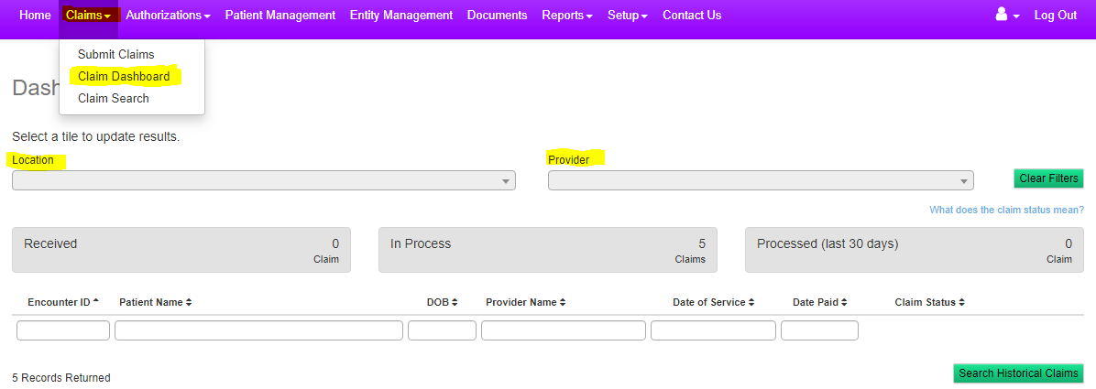
Claim Dashboard
This is a feature of the online portal that allows users to view claims submitted, sorted by location and provider
  Used to search claims under provider/location
  Check claims received, in process, and processed from this tool

Slide 12
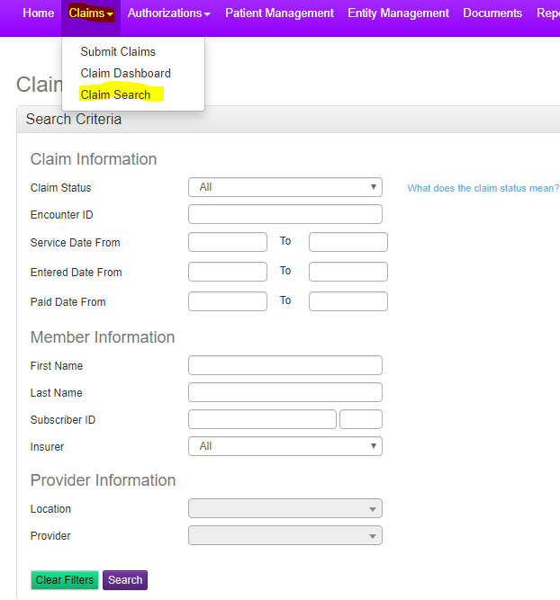
Claim Search
The “Claims Search” feature allows users to search for specific claims
Search using claim number, member information, and provider information if necessary

Slide 13

Corrected Claims
Corrected Claims can be submitted via PWP or Paper Mail.
Corrected Claim Requirements:
  2012 ADA Form or Newer Version ( mailing only)
  Write Corrected Claim at the top of the form (mailing only )
  On box 35 or in a separate narrative please advise why you’re sending a corrected claim (mailing only)
  Attach any supporting documents
  Please review Provider Manual for mailing address
  Contact customer service for additional assistance

Slide 14
Claim Appeals
All appeals need to be mailed
Requirements:
  2012 ADA Form or Newer Version
  In a separate narrative please advise why you’re
  appealing the claim
  Attach any supporting documents
  Please review Provider Manual for mailing address
  Contact customer service for additional assistance

Slide 15

Timely Filing Deadlines
Every process has their own timely filing
  Please be sure to check the provider manual for additional information.
Medicaid and Medicare have different timeframes

Slide 16
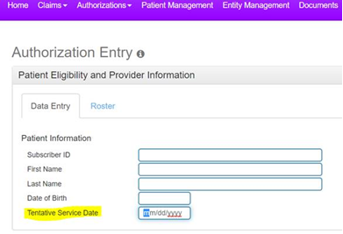
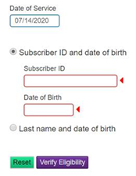
Authorizations
There are two main ways to submit Prior-Authorizations:
Requirements are listed on the Benefit Grid or Clinical Policies
Tentative date must be at least two weeks – one month out (Retrospective Authorizations cannot be submitted online)
Examples below……
  Mail (Please review provider manual or contact customer service for address)
1
  Provider Web Portal
2

Slide 17

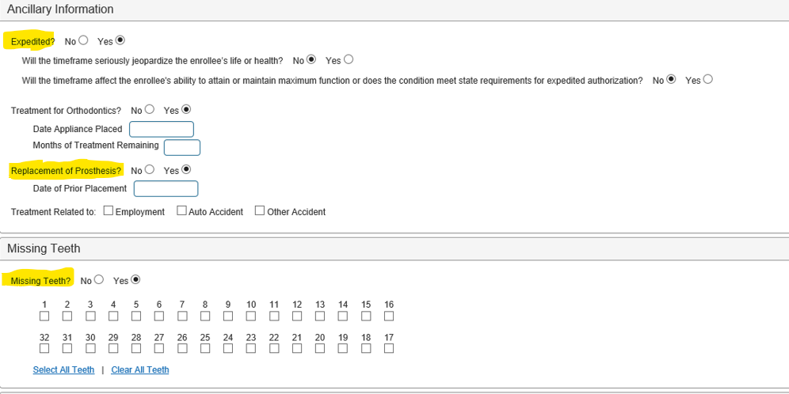

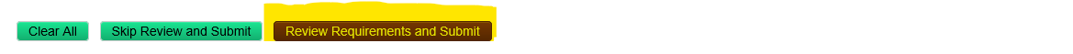
Authorizations
COC only
NEA # in remarks

Slide 18

Reconsideration/Authorization Appeals
Please contact Customer Service at the number in the Provider Manual for additional information as some requests cannot be submitted through the portal

Slide 19
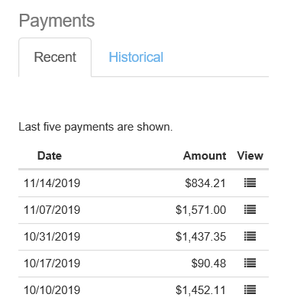
Evidence of Payment (EOP)
Remittance Advice
“Payee” accounts have access to view EOPs online
Other types of user accounts cannot view EOPs online
Located on the bottom right side of the landing page

Slide 20
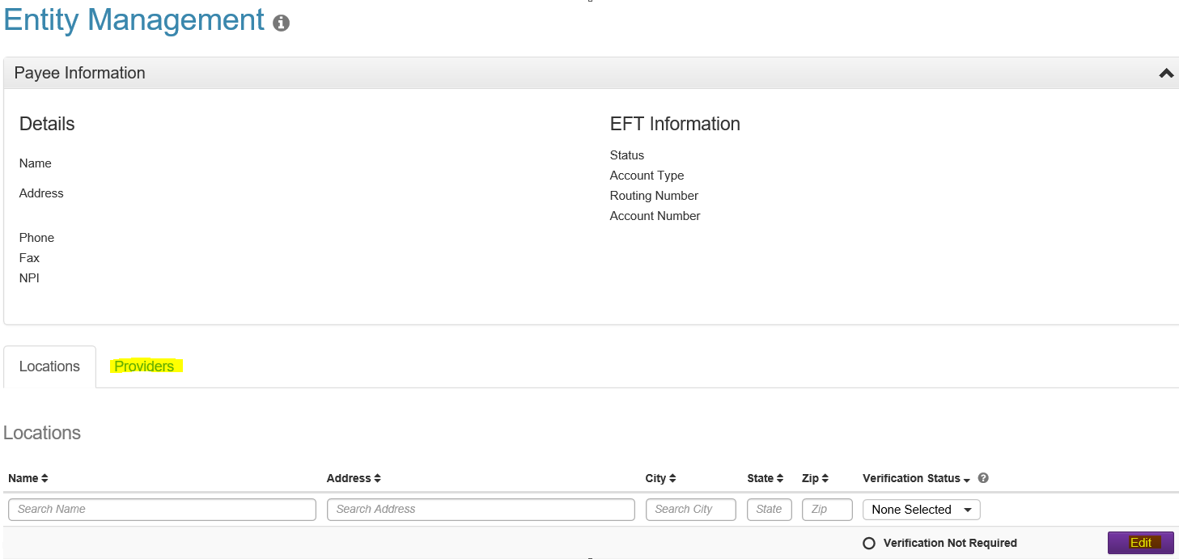
Entity Management
- Entity Management will allow you to update provider information, office hours & information. Step by step process on the following slide.
*** United Concordia Providers Only***
You will notice in option in Entity Management to submit Demographic Changes. Please refrain from submitting Termination requests or Address changes through the Provider Web Portal; as these changes will need to be completed through United Concordia. You can reach United Concordia using Email: ProviderRequests@ucci.com Phone: 800-307-8514 Fax: 1‐844‐235‐7261 Mailing Address:
Provider Data Management
PO Box 69404; Harrisburg, PA 17106-9404

Slide 21
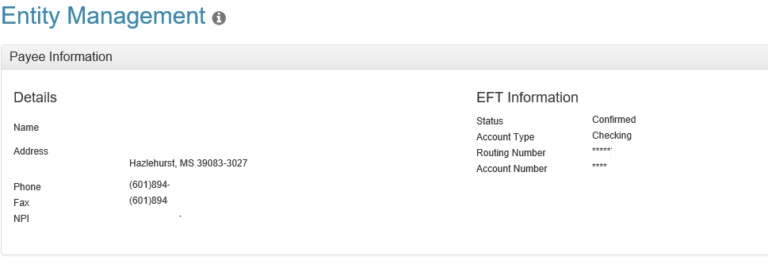
Provider & Location Verification Process
Slides 19-26
Step 1. In the purple bar below click on Entity Management
Step 2. You will see the screen below once you follow Step 1.

Slide 22
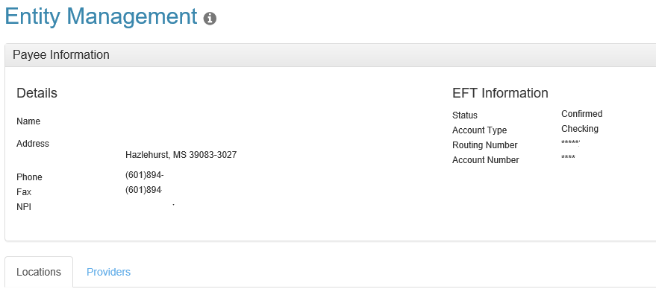
Provider & Location Verification Process Continued…..
Step 3. Excluding the omitted office name, NPI and address, the payee information will be listed at the bottom. There will be a tab for locations and providers that can verified.

Slide 23
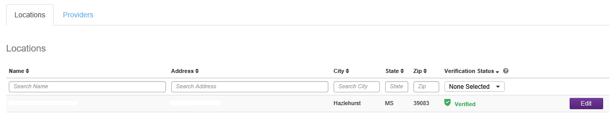
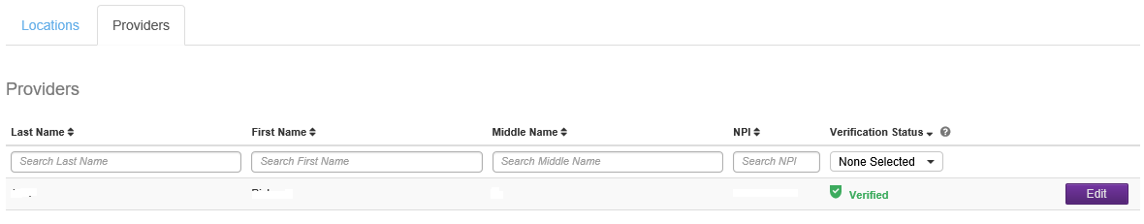
Provider & Location Verification Process Continued…..
Step 4. On each tab you will either list the location name & address under the location tab, or provider first name, last name, middle initial and NPI under the provider tab. Both tabs will have an edit button available to you.

Slide 24
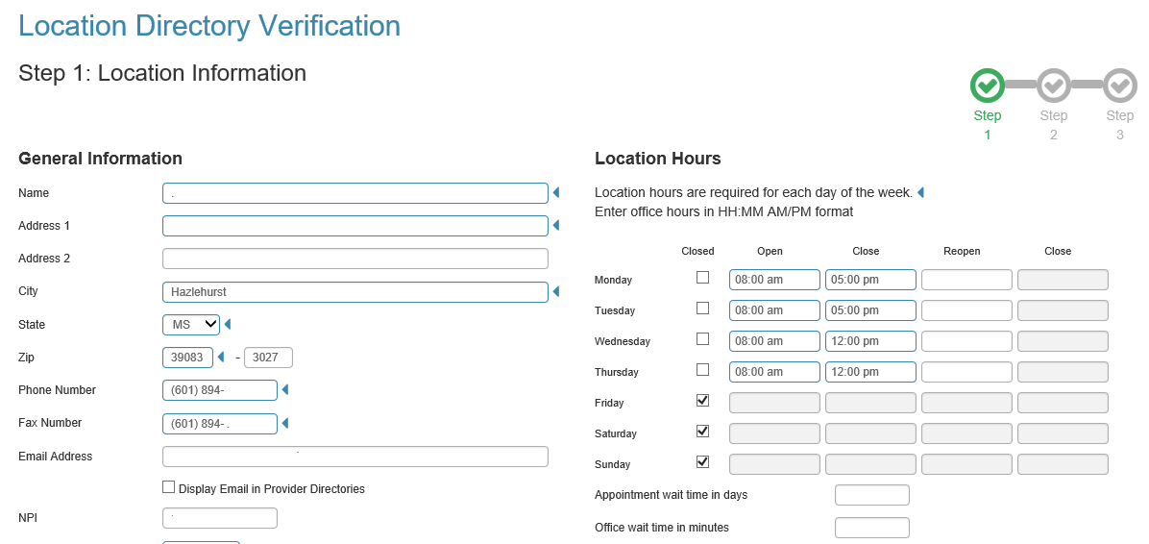
Provider & Location Verification Process Continued…..
Step 5. If you click the “edit” button for the location, the screens will look similar to the below; however all of the practice’s information will be listed. In addition there are 3 steps to verify (all listed below and following additional slides 23 & 24)
Notes:
If you are attempting to change a location name or address, that should come through your PR Rep. Although you are given the options, we have found that many times offices are typically trying to close one location and changing it to a new location. That requires documentation to term from one location and addition of the new location with a W-9 and (typically) an updated Roster. We will Deny these types of requests.
During this verification process, you may learn that you have multiple locations active at the same address but with a different name, again any complex correction like that requires assistance from your PR rep. We will Deny these types of requests.
If you are only correcting a STE # or zip code (something minor), then it’s ok to do so here.

Slide 25
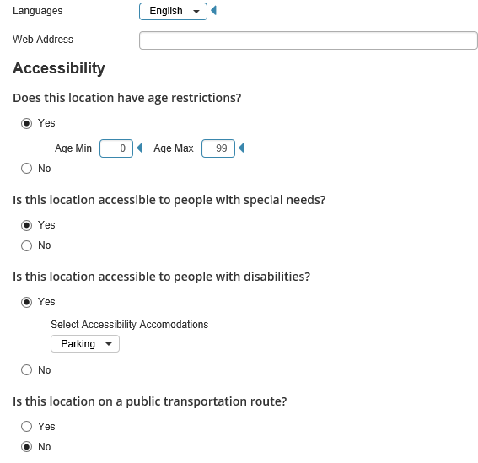
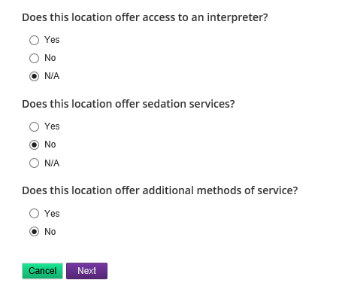
Provider & Location Verification Process Continued…..

Slide 26
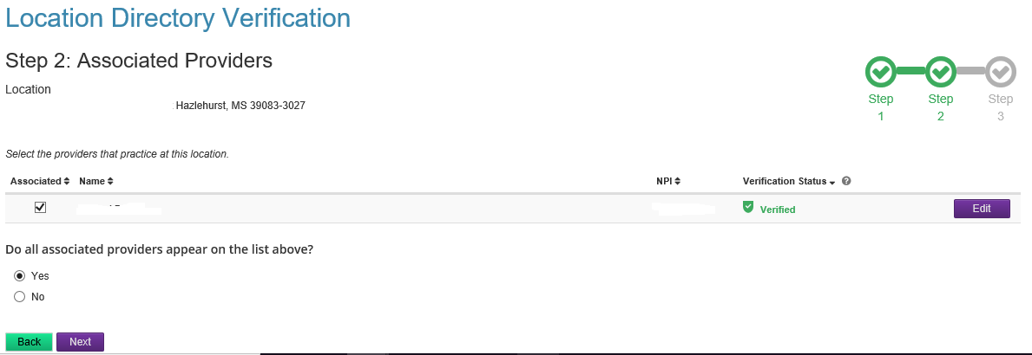
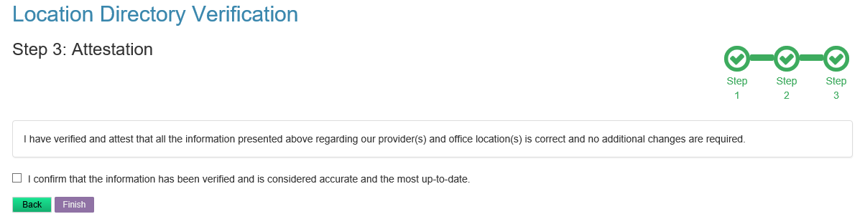
Provider & Location Verification Process Continued…..
Notes:
If you select ‘No’ under the box for ‘Do all associated providers appear on the list above?’ –
If you are terming a provider – you must add the provider name and term date in the ‘Notes’ section – if you do not, we will Deny this request because we can’t term without a date.
If they are attempting to add a provider – you must contact your PR Rep. This tool does not give you an option to list names for adding a new provider. In addition there are credentialing requirements that should be checked by the PR Rep before this can occur.

Slide 27
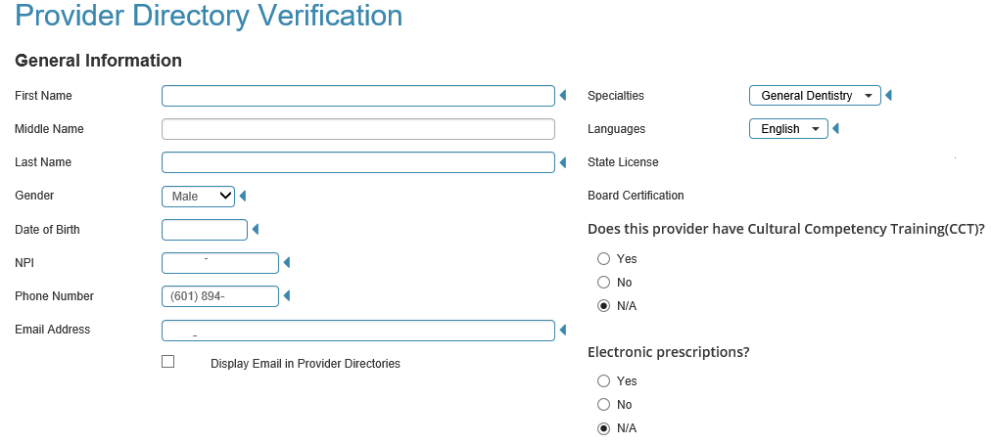
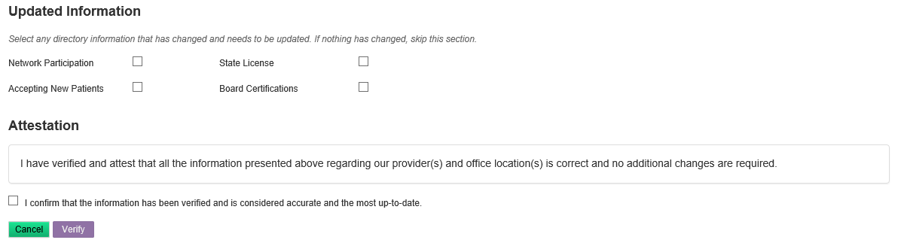
Provider & Location Verification Process Continued…..
Step 6. Once you click on the option “Edit” for the provider tab, the screen will look identical the below screenshot and will there will only be one step process.

Slide 28
Provider & Location Verification Process Continued…..
Most importantly ensure you click on the boxes that will advise you to confirm the information provided before choosing the verify option. If you attempt to click on finish/verify and you find that it’s not going through; it’s simply because that box has not been selected.
Notes:
Lastly if a provider requested action that can’t be performed, we will send them a message as to why it wasn’t performed. They will then need to check for a message and follow the instructions given to them.

Slide 29
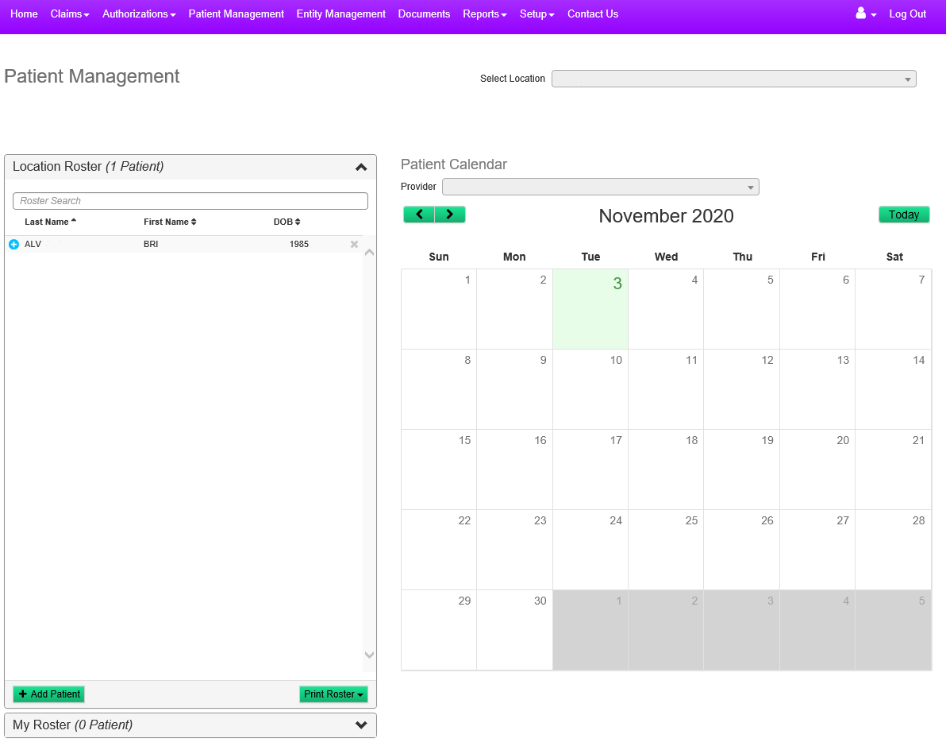
Patient Management
This section covers the Patient Management feature
This feature allows users to create a roster of patients
The roster can then be used to schedule member appointments for the month
It also allows users to check eligibility for every member scheduled on that day – in 1 click

Slide 30
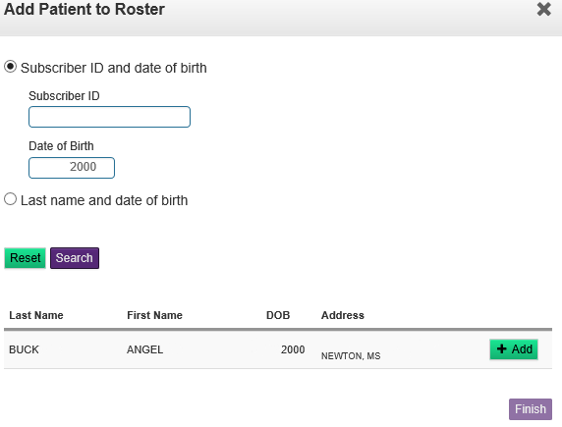
Patient Management Continued…..
Patient Management will have users Add Members to the roster
It will be a similar search window as eligibility
Once the members are added to the roster, then they can be added to the calendar

Slide 31
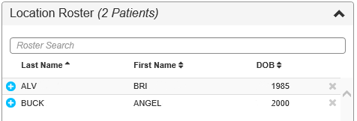
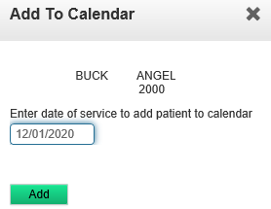
Patient Management Continued…..
To add members from the roster to the calendar, click on the blue “+” sign next to their name
From there, the pop up will ask for a date of service to enter the member in the calendar

Slide 32
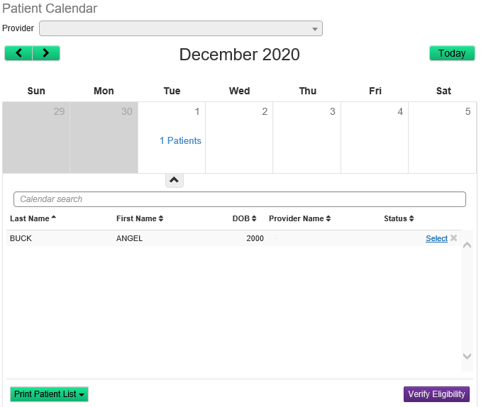
Patient Management Continued…..
The member(s) have been successfully added to the calendar for the date of service entered.
Users can check the eligibility for all members scheduled for the day – using the Verify Eligibility button on the bottom right

Slide 33
End of Presentation
Envolve’s Customer Service team can be reached using
Toll Free: 855-735-4395 for assistance with our web portal and answers to general questions such as eligibility, benefits, and more.

